Slide 1
Mobile device security
Nguyễn Văn Đông (11070444)
Trần Nữ Quỳnh Như (09070457)

Slide 2
Agenda
Why mobile security?
How to protect
Encrypt data on mobile device
Example application
Course work

Slide 3
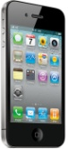
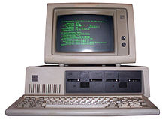
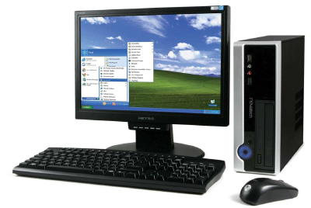


Why mobile security?
Mobile devices become more and more popular and powerful
Notes:
IBM 5150 (1981)
CPU: Intel8088@4.77MHz
Memory: 16kB~256kB

Slide 4

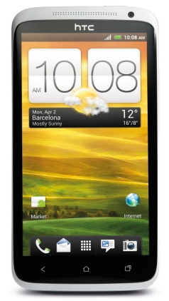
Why mobile security?
Mobile devices become more and more popular and powerful
HTC One X
1,5Ghz Quad-core
1GB RAM
1.280 x 720 display
Notes:
DynaTAC 8000X (1983)

Slide 5
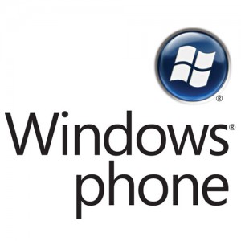






Why mobile security?
Mobile devices become more and more popular and powerful
Variety platform - OS

Slide 6

Why mobile security?
Mobile devices become more and more popular and powerful
Variety platform - OS (iOS, Android, BlackBerry,...)
It's personal
Easier to misplace or steal
Less user concern

Slide 7
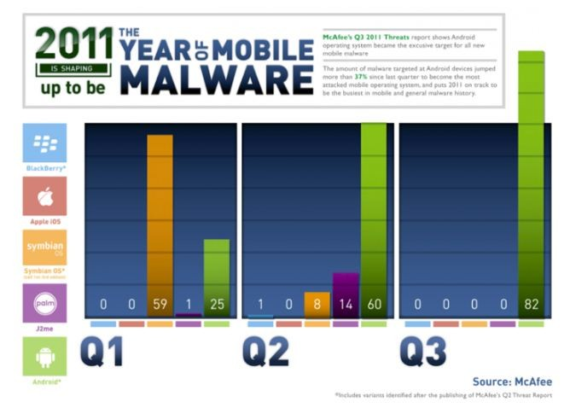
Why mobile security?

Slide 8
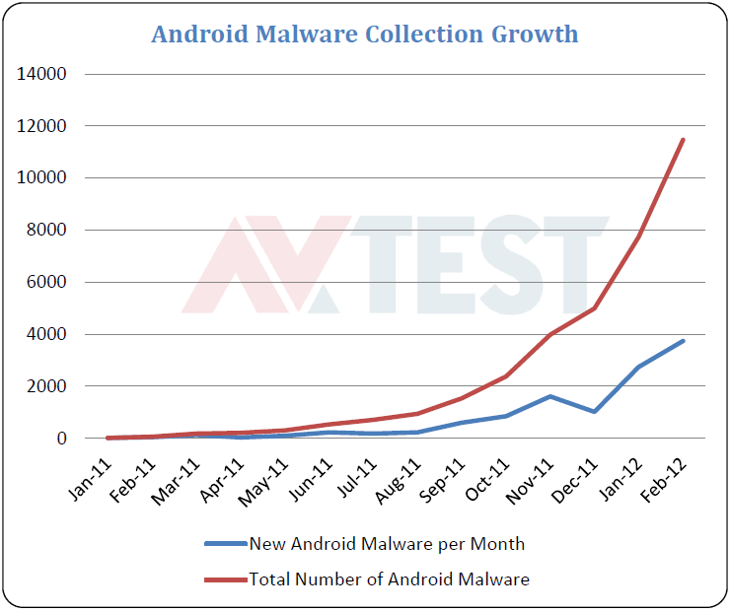
Why mobile security?

Slide 9
Why mobile security?
Threats:
Device loss
Unsecured wireless
Malware, malicious websites
Location tracking
Threat to enterprise

Slide 10
How to protect
Policy:
Limit type of devices
Limit mobile application
Limit data stored on devices
Devices must be protected by password
Devices must be protected by tools
Users are responsible for physical secure and report when loss
…

Slide 11
How to protect
User attention:
Should not "jailbreak" or "root" your device
Do not install software from un-trusted source
Update firmware frequently, configure automatic updates if possible
Configure mobile devices securely
Do not connect to unsecure Wi-Fi networks
Utilize anti-virus programs

Slide 12
How to protect
User attention:
To protect confidential data in case of loss:
Use an encryption solution to keep portable data secure in transit
Enable remote wipe or auto-wipe after a number of fail login
…

Slide 13
Encrypt data on mobile device
Why
Extracting data from a mobile device is possible even if the device password is not known:
Connect to PC and run a special application
Read SD card/memory flash directly

Slide 14
Encrypt data on mobile device
Full-disk encryption (FDE): encrypt entire disk, including OS, system files…
File system encryption: Encrypt particular files or folders

Slide 15
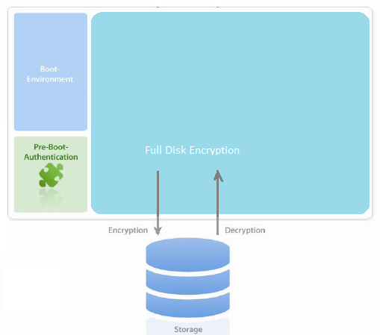
FDE: How it encrypts

Slide 16
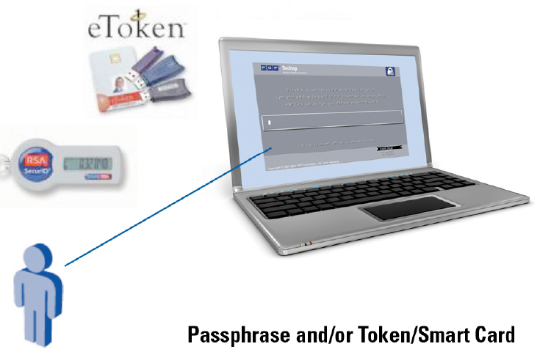
FDE: Pre-boot authentication
Pre-boot screen -> users provide credentials/security token
If success, OS is loaded and users can use the system

Slide 17
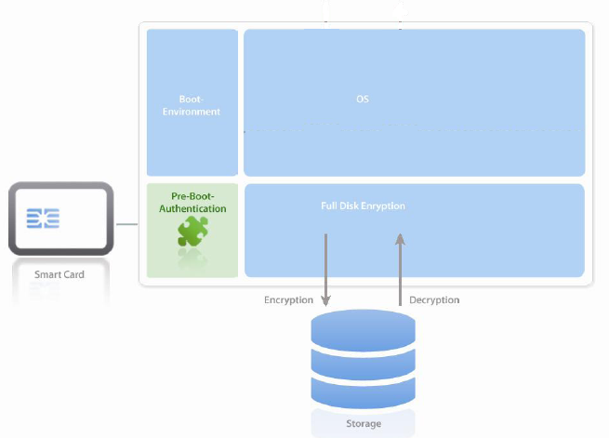
FDE: Login successfully
All data read(written) from(to) hard disk by OS or any app is handled by FDE
-> no unencrypted data in memory

Slide 18
Full Disk Encryption
Advantage
Everything is encrypted
Transparent to user
Disadvantage
Protect data from the theft, not from unauthorized access when boot up successfully

Slide 19
File System Encryption
Encrypt specific files or folders which contain sensitive data

Slide 20
File System Encryption
Advantage
More flexible than full-disk encryption
Protect data from unauthorized access and malware
Disadvantage
Depend on user action
Difficult to deploy and manage from a policy point of view

Slide 21
Encrypt data on mobile device
Cryptography system:
Token-based
Password-based
Biometric-based

Slide 22
Password-based Cryptography
Password is not directly applicable as a key
-> need to perform extra processing

Slide 23
Password-based Cryptography
Key derivation functions
Salt:
Increase output key space
Difficult to pre-compute a set of key
Iteration:
Make KDF more complex
Should be >= 1000
Salt and Iteration count is not secret
Password
Salt
KDF
Cryptographic key

Slide 24
Password-based Cryptography
PBKDF1
PBKDF2

Slide 25
Password-based Cryptography
PBKDF1:
PBKDF1 (P, S, c, dkLen)
P: Password
S: Salt
c: iteration count
dkLen: Expected output key length
Option: Underlying hash function (MD2, SHA-1)
Output key length is limited by used hash function:
16 for MD2
20 for SHA-1

Slide 26
Password-based Cryptography
PBKDF1
Salt
Password
Hash
(MD2 or SHA-1)
Loop c time
Cryptographic key

Slide 27
Password-based Cryptography
PBKDF1
PBKDF1 (P, S, c, dkLen)
T_1 = Hash (P || S)
T_2 = Hash (T_1)
...
T_c = Hash (T_{c-1})
DK = T_c<0..dkLen-1>

Slide 28
Password-based Cryptography
PBKDF2:
PBKDF2 (P, S, c, dkLen)
P: Password
S: Salt
c: iteration count
dkLen: Expected output key length
Option: Underlying pseudorandom function (HMAC-SHA-1)
Output key length <= (2^32 - 1) * hLen
hLen is output length of pseudorandom function

Slide 29
Password-based Cryptography
PBKDF2
n = CEIL(dkLen / hLen)
Salt||1
Password
Salt||n
Password
Loop c time
PRF
Loop c time
PRF
…
XOR
XOR
Cryptographic key (T1)
||…||
Cryptographic key(Tn)

Slide 30
Password-based Cryptography
PBKDF2
PBKDF2 (P, S, c, dkLen)
T_i = F(P, S, c, i) // i = 1..n
F(P, S, c, i) = U_1 xor U_2 xor ... xor U_c
U_1 = PRF(P, S || INT (i))
U_2 = PRF(P, U_1)
...
U_c = PRF(P, U_{c-1})
DK = Get first dkLen(T_1 || T_2 || ... || T_n)

Slide 31
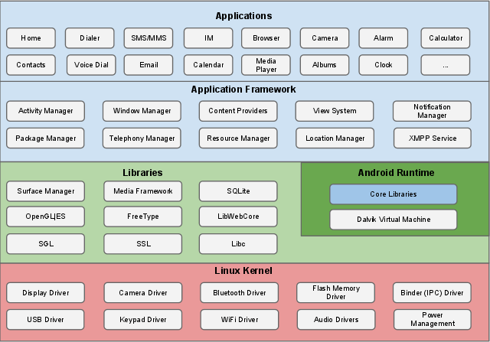
Android security

Slide 32







Android security

Slide 33
Android security feature
Linux kernel
Protect system resources (Camera, GPS, network,…)
Application-defined and user-granted permission
Application Sandbox (kernel level) with secure inter-process communication
Device Administration
Memory Management Security Enhancements
Application signing
Notes:
Linux kernel provides Android with several key security features, including:
A user-based permissions model
Process isolation
Extensible mechanism for secure IPC
The ability to remove unnecessary and potentially insecure parts of the kernel
Android includes many features that make common security issues harder to exploit. The Android SDK, compilers, and OS use tools to make common memory corruption issues significantly harder to exploit, including:
Address Space Layout Randomization (ASLR) to randomize key locations in memory
Hardware-based No eXecute (NX) to prevent code execution on the stack and heap
ProPolice to prevent stack buffer overruns
safe_iop to reduce integer overflows
Extensions to OpenBSD dlmalloc to prevent double free() vulnerabilities and to prevent chunk consolidation attacks. Chunk consolidation attacks are a common way to exploit heap corruption.
OpenBSD calloc to prevent integer overflows during memory allocation
Linux mmap_min_addr() to mitigate null pointer dereference privilege escalation

Slide 34
Android security feature
Lock screen, unlock mechanism:
Slide pattern
PIN
Password

Slide 35
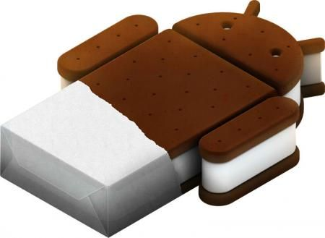
Android security feature
What new on ICS:
Face unlock
Full-disk encryption
AES128 with CBC and ESSIV:SHA256
The encryption key is protected by AES128 using a key derived from the user password
Custom message on lock screen
Disable pre-installed application
Notes:
essiv: "encrypted sector|salt initial vector”
IV(sector) = E(s, sector), s = hash(K)

Slide 36



Android security feature
Encryption key
User password
PBKDF2
Crypto footer
Random master key
128bit AES
Disk
128bit AES

Slide 37
Android security feature
Crypto footer:
Locate at the last 16kB of the devices
Contain:
Encryption detail
Encryption status
Encrypted master key

Slide 38
Android security feature
Enabling encryption on the device
User select to encrypt device
Check if able to encrypt
No
Yes
Unmount /data and /mnt/sdcard
Mount tmpfs /data
For each block:
Read from disk
Encrypt
Write encrypted data
Write crypto footer
Check encrypt error
Error
Success
Update crypto footer
Reboot
Display error

Slide 39
Android security feature
Booting an encrypted system
Boot up
Prompt for user password
Succcess
Mount /data
Fail
Check password
Mount tmpfs /data
Fail
Success
Unmount tmpfs /data
Mount decrypted /data

Slide 40
Android security weakness
Root device
Openness and Fragmentation
System update depends on manufactures

Slide 41
Android security
Protect your devices:
Should not "root"
Enable auto-update
Should not install application from un-trusted source
Examine permission list carefully before installing
Use password or PIN to lock
Enable full-disk encryption
Do not connect to unsecure Wi-Fi networks
Utilize anti-virus programs
…

Slide 42
Android security
Recommended free security app:
Lookout Security & Antivirus
Avast! Mobile Security
NQ Mobile Security & Antivirus
AV-Test result:
http://www.av-test.org/fileadmin/pdf/avtest_2012-02_android_anti-malware_report_english.pdf

Slide 43
Course work
A CryptNote application:
Allow user to create, modify and delete text notes
Encrypted note is store on database
User enter password to authenticate when application start
Password is configure for virgin application and changeable.
Key generation algorithm similar to Android system:
Random key for master key
Master key is encrypted using a key derived from password

Slide 44
References
http://source.android.com/tech/security/index.html
http://source.android.com/tech/encryption/android_crypto_implementation.html
Sunitha Medayil Vijayamma(2009) - A Security Overview in Google’s Open Source Android Phone
http://en.wikipedia.org/wiki/Disk_encryption_theory
RFC 2898 (http://www.ietf.org/rfc/rfc2898.txt)
http://anandam.name/pbkdf2/
http://www.av-test.org/fileadmin/pdf/avtest_2012-02_android_anti-malware_report_english.pdf
...

Slide 45
Thank you
Question ???

